Slide 1
Siyan Liu
Movie App By
Miaomiao Hou
Miaomiao Hou

Slide 2
1
Topic and Dataset
Movie development
2
Analysis:Q1
The development of movies these years
catalogue
3
Analysis:Q2
Which country is the most competitive
4
APP demo
A demo of our movie app

Slide 3
01
Part one
Topic and Dataset
Movie development

Slide 4
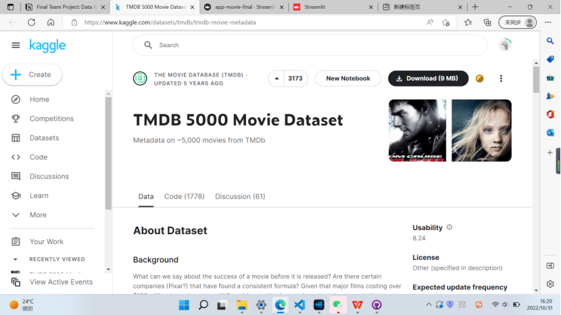
Topic and Dataset
TMDB 5000 Movie Dataset
国外研究
We chose the TMDB 5000 Movie Dataset and made a
movie app, which can show the information about movie development.
您的内容打在这里，或者通过复制您的文本并悬着只保留文本。您的内容打在这里，或者通过复制您的文本并悬着只保留文本。您的内容打在这里，或者通过复制您的文本并悬着只保留文本。
国外研究
您的内容打在这里，或者通过复制您的文本并悬着只保留文本。您的内容打在这里，或者通过复制您的文本并悬着只保留文本。您的内容打在这里，或者通过复制您的文本并悬着只保留文本。
https://www.kaggle.com/datasets/tmdb/tmdb-movie-metadata

Slide 5
02
Part two
Analysis:Q1
The development of movies these years

Slide 6
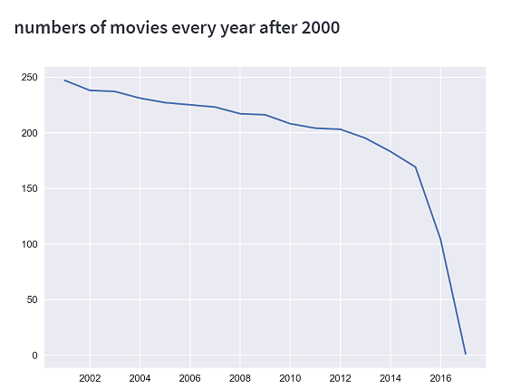
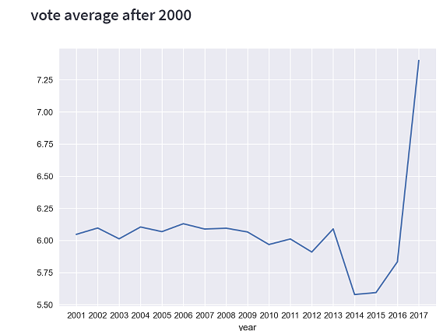
Analysis:Q1
The average vote of movies after 2000
In this picture,the vote average decreases sharply in 2014, which reached the lowest point and rises suddenly in 2017
The quantity of movies after 2000
We find that the quantity of movies is declining.It decreases sharply after 2015

Slide 7
Analysis:Q1
Analysis:Q1
Because of the number of movies in 2017 is too small, so it can't be used as a reference for the average vote
All in all,the quantity of movies is declining and the average vote is relatively stable.Occasionaly,there are some ups and downs.

Slide 8
03
Part three
Analysis:Q2
Which country is the most competitive

Slide 9
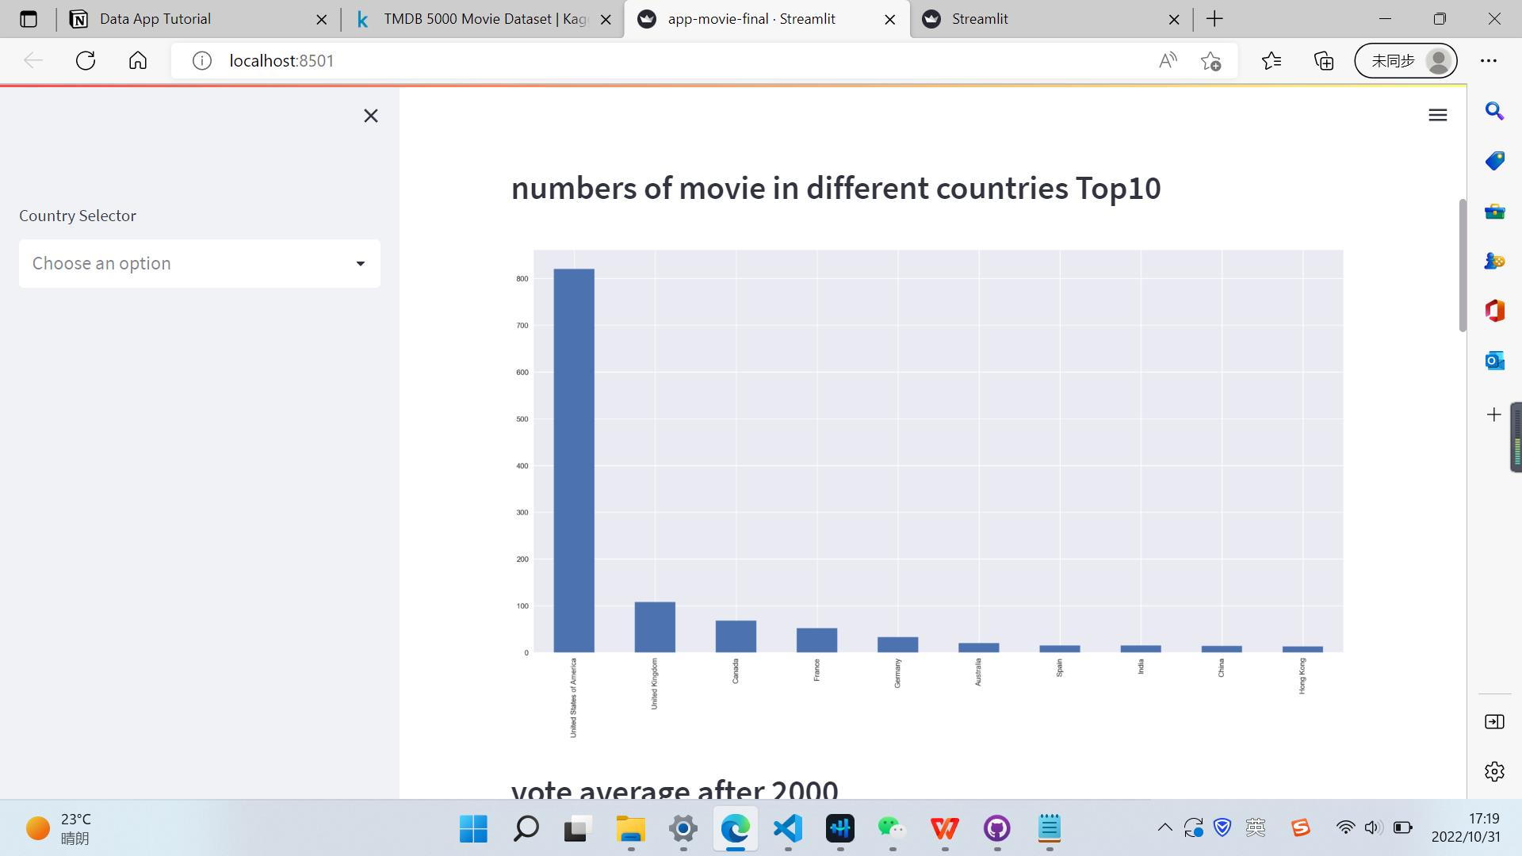
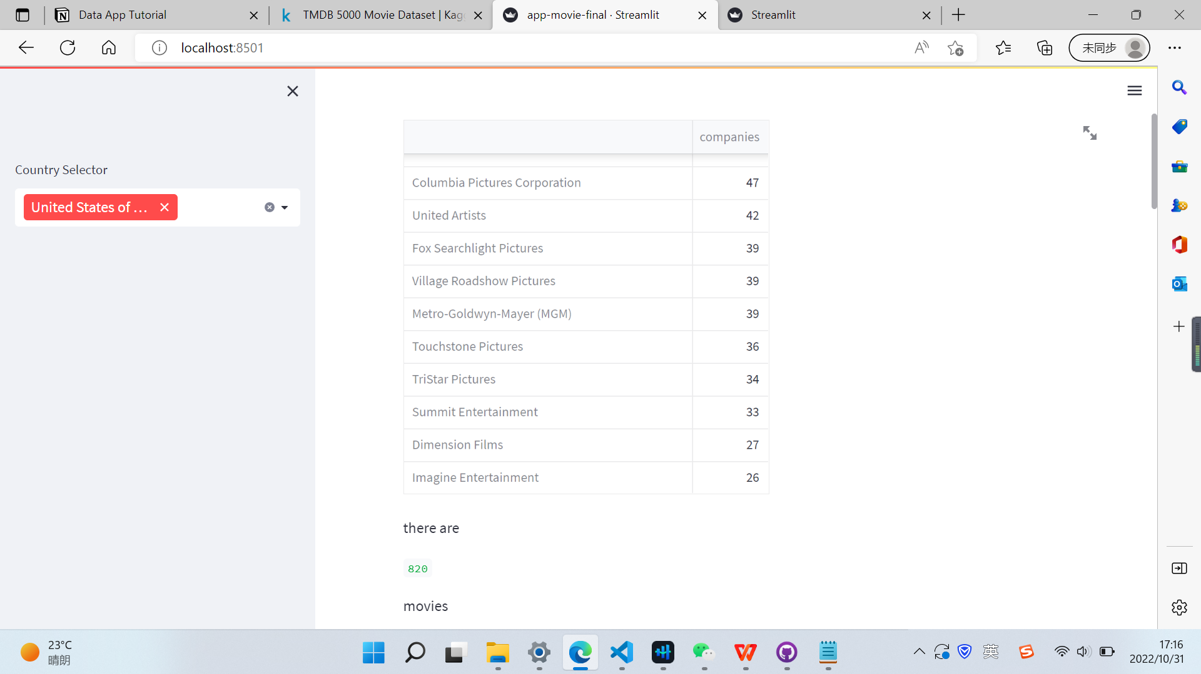
Analysis:Q2
Which country is the most competitive?

Slide 10
04
Part four
APP demo
A demo of our movie app

Slide 11
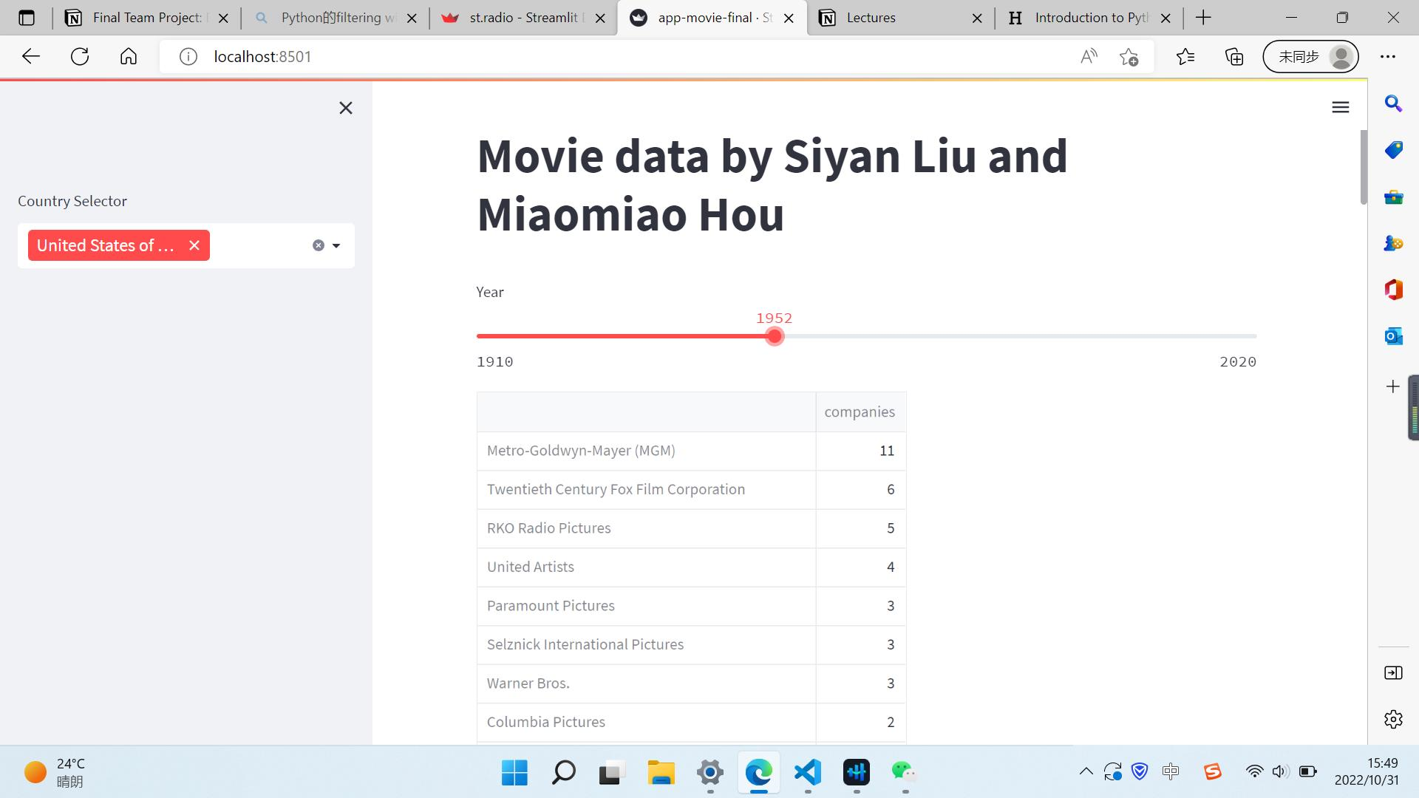
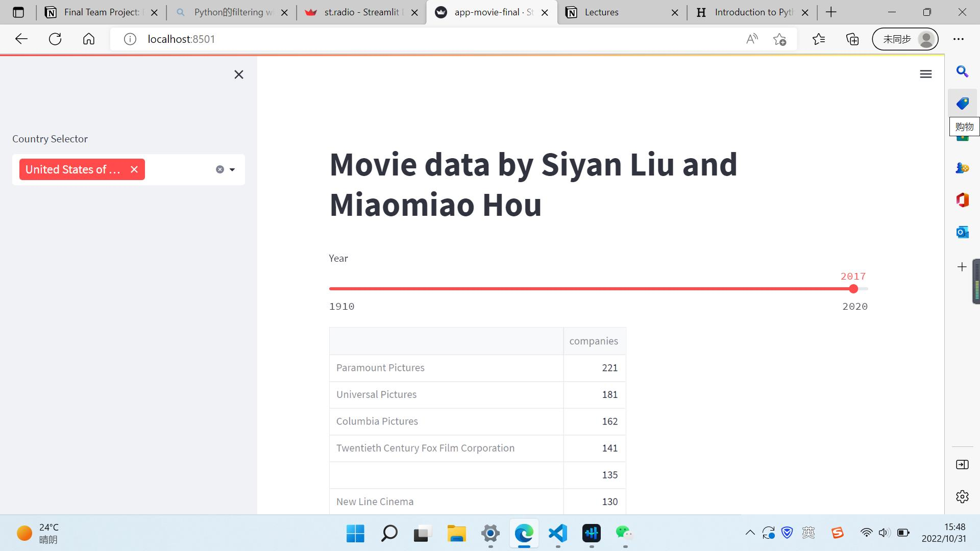
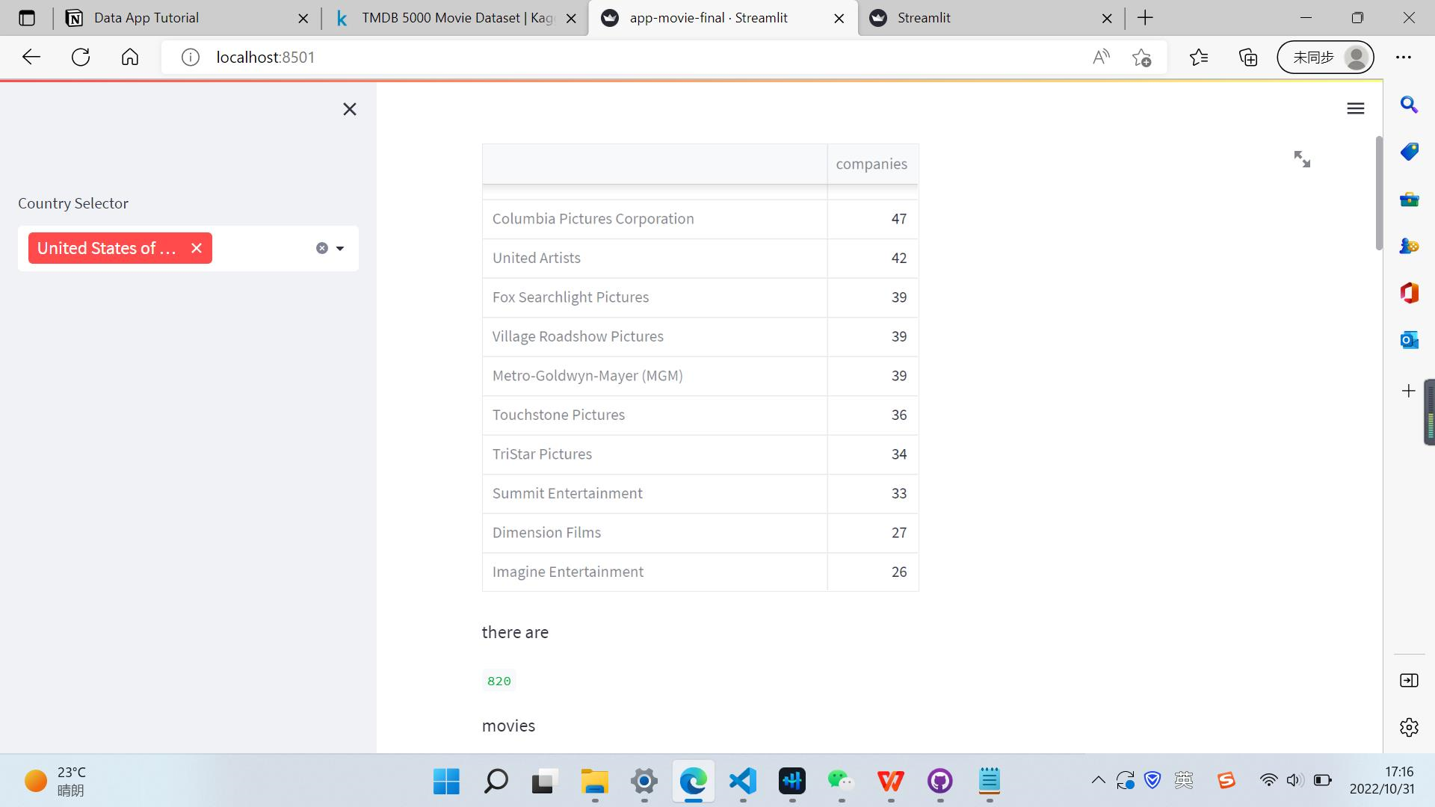
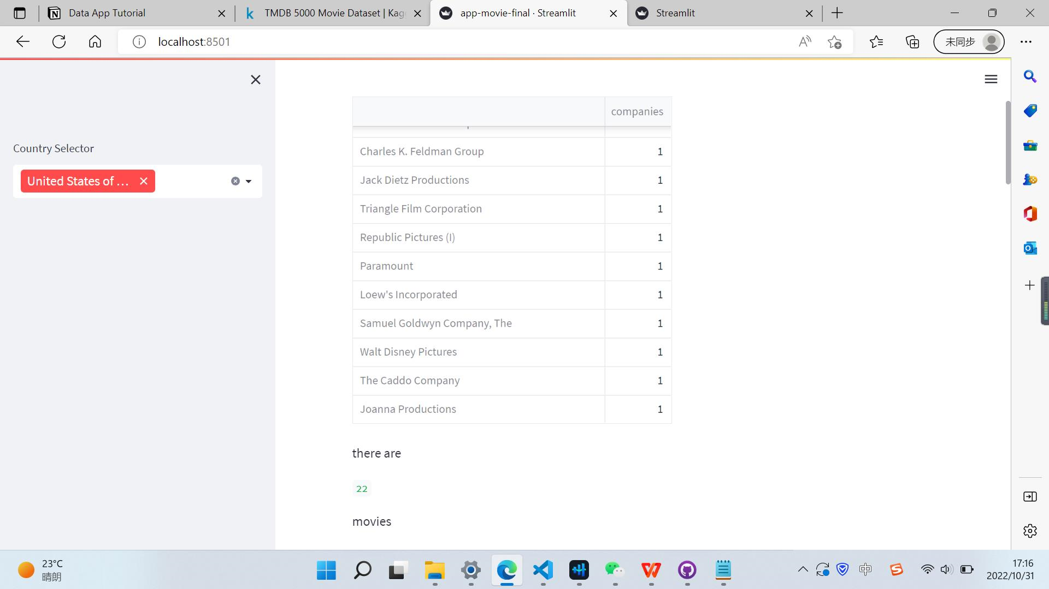
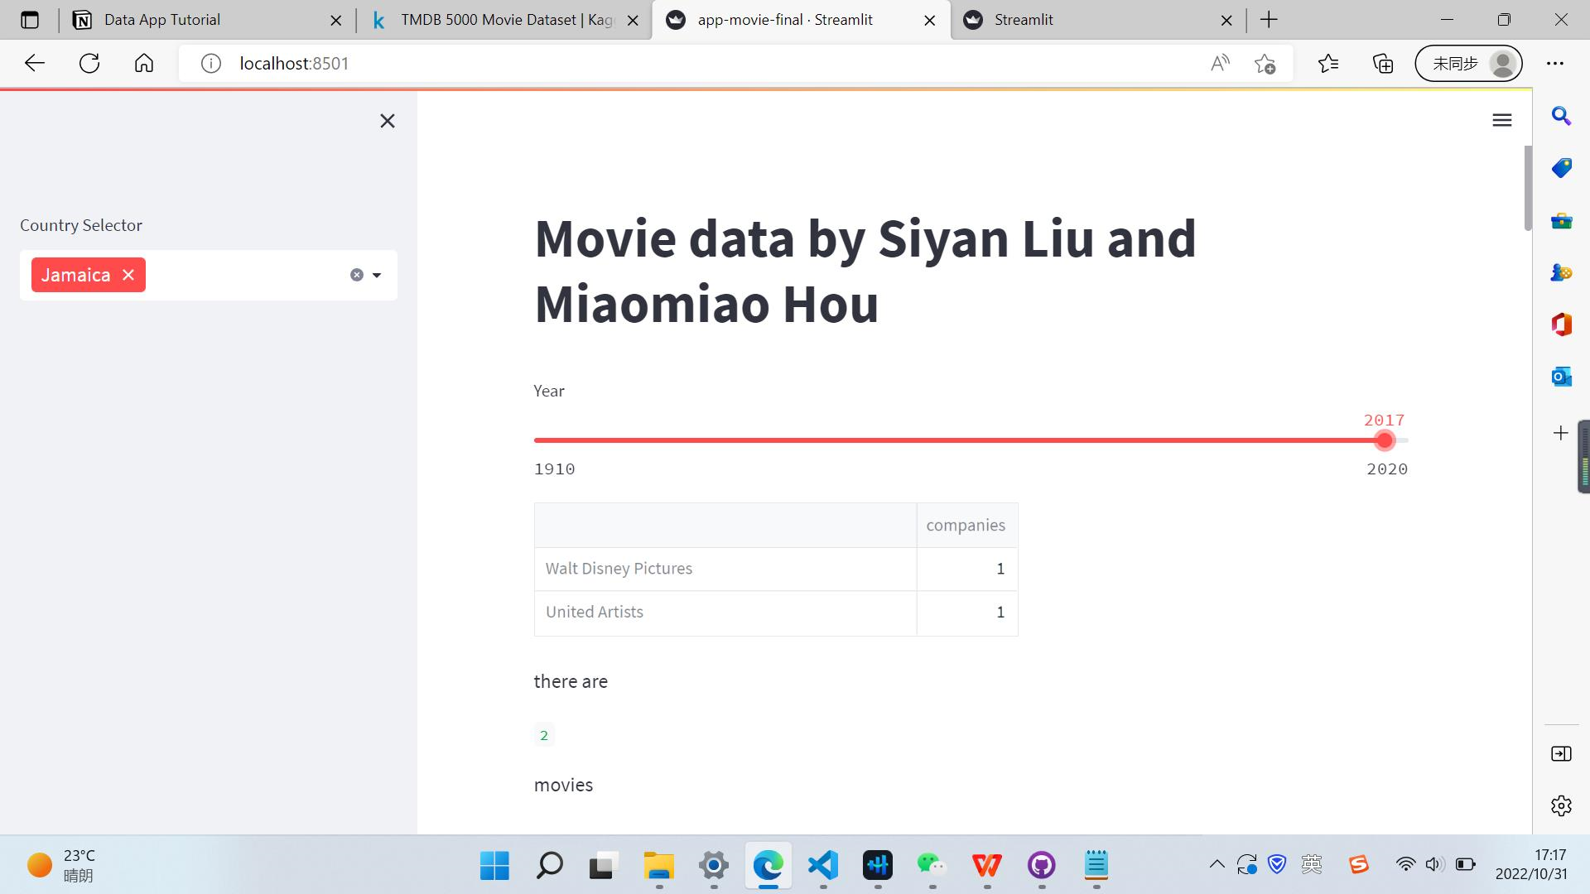

chart
APP demo

Slide 12
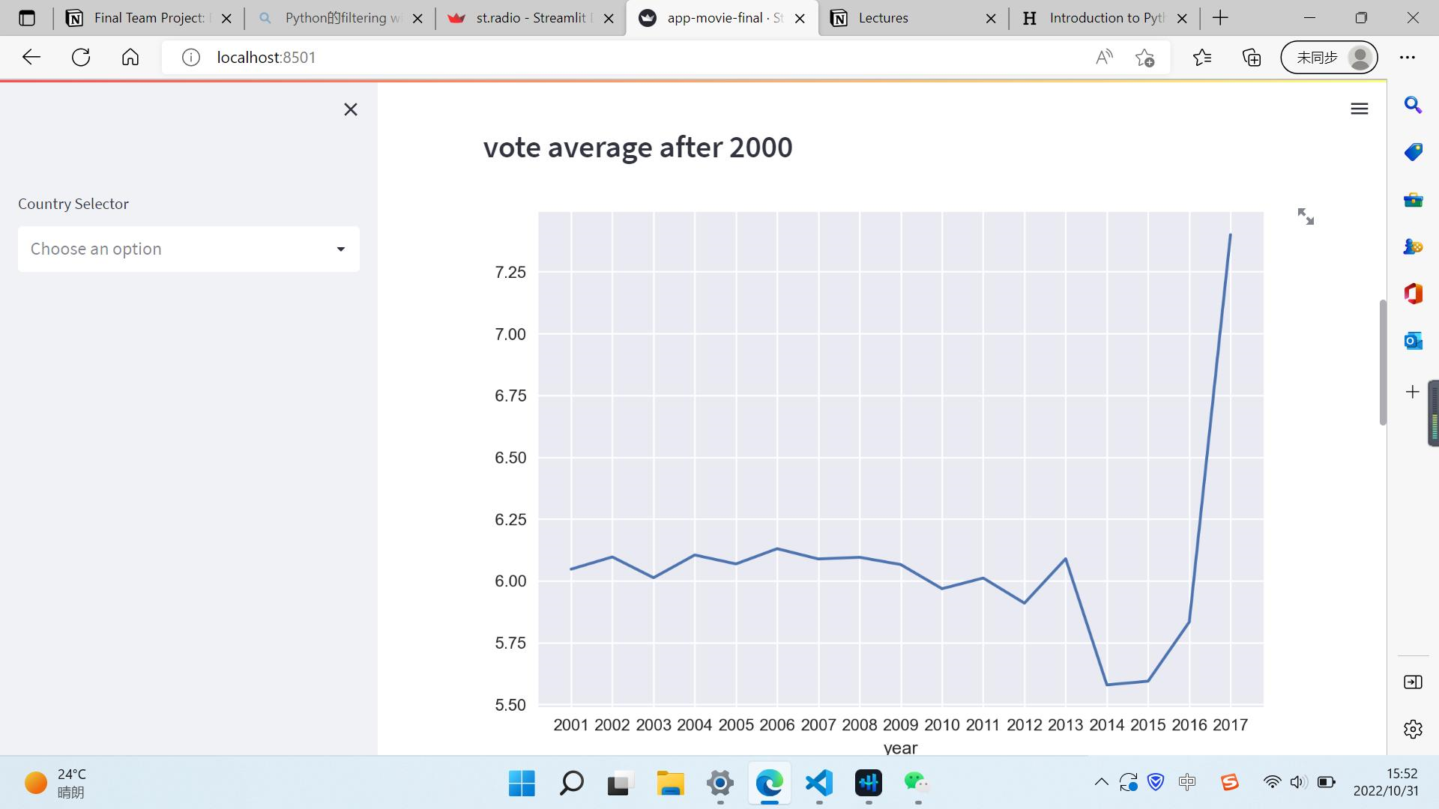
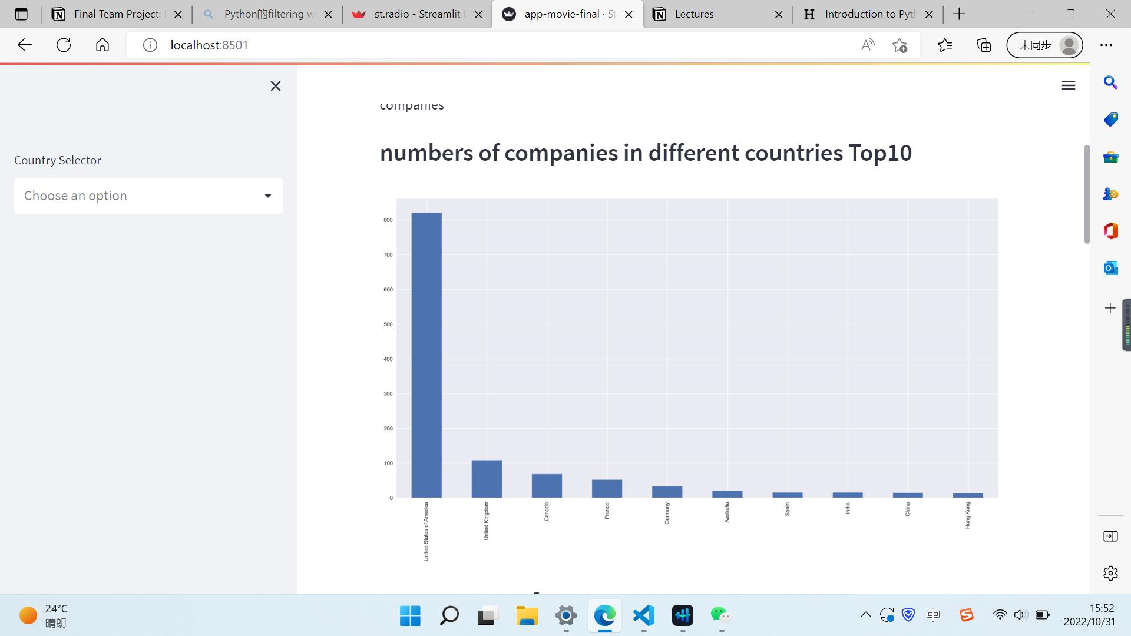
chart
APP demo

Slide 13
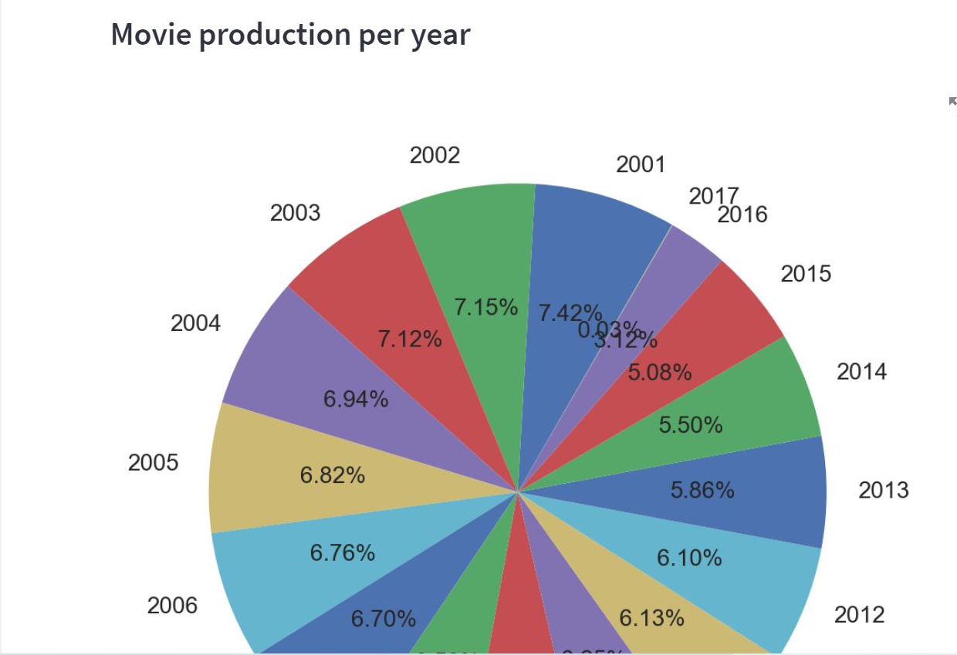
chart
APP demo

Slide 14
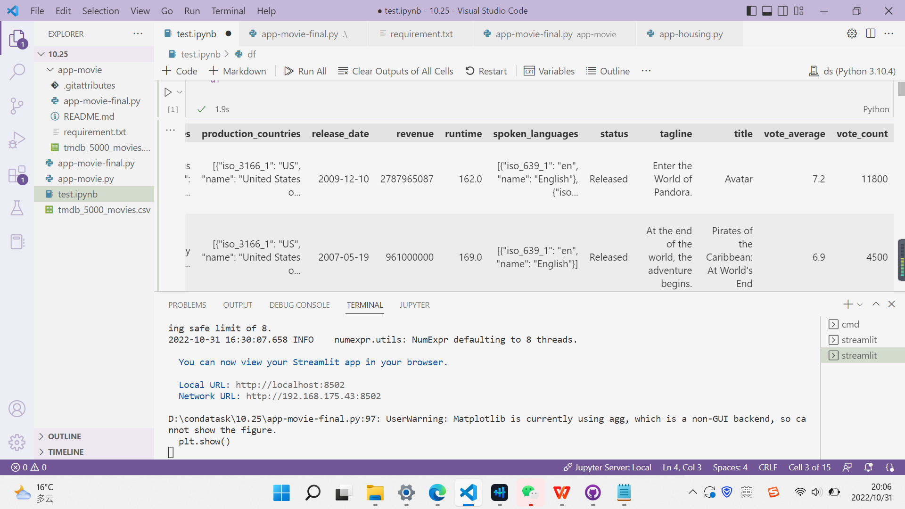
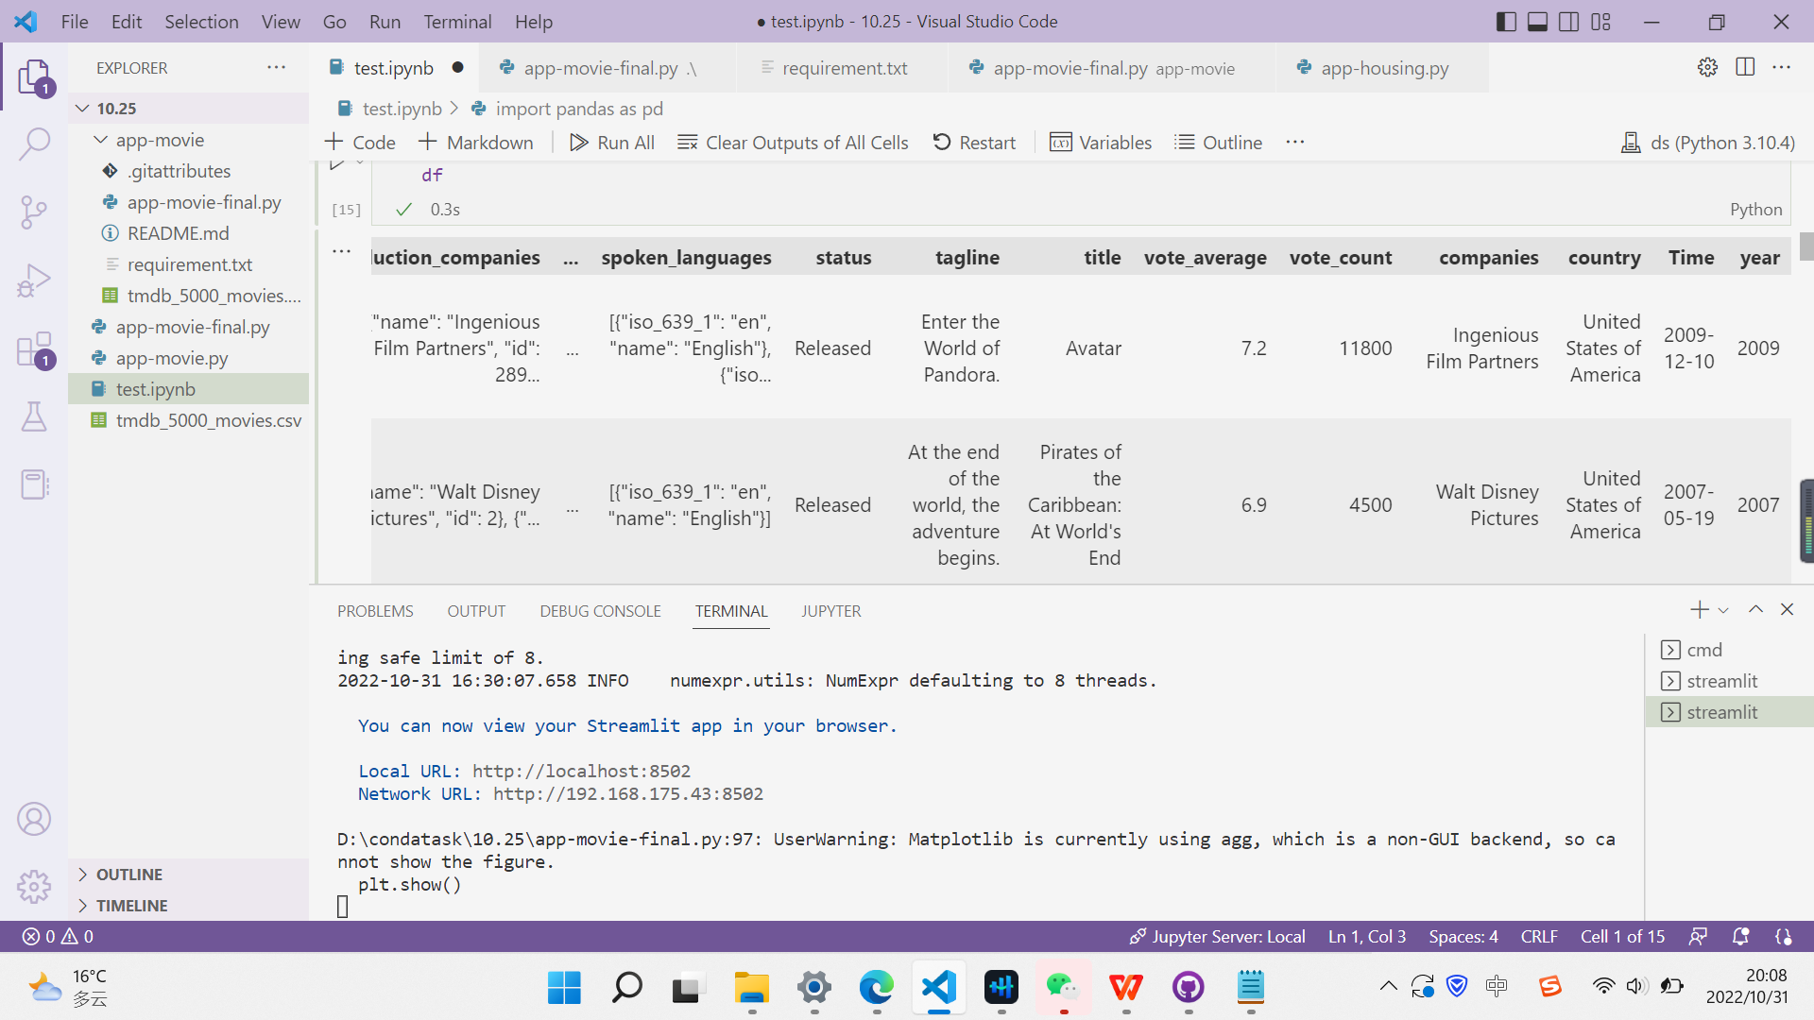
APP demo

Slide 15
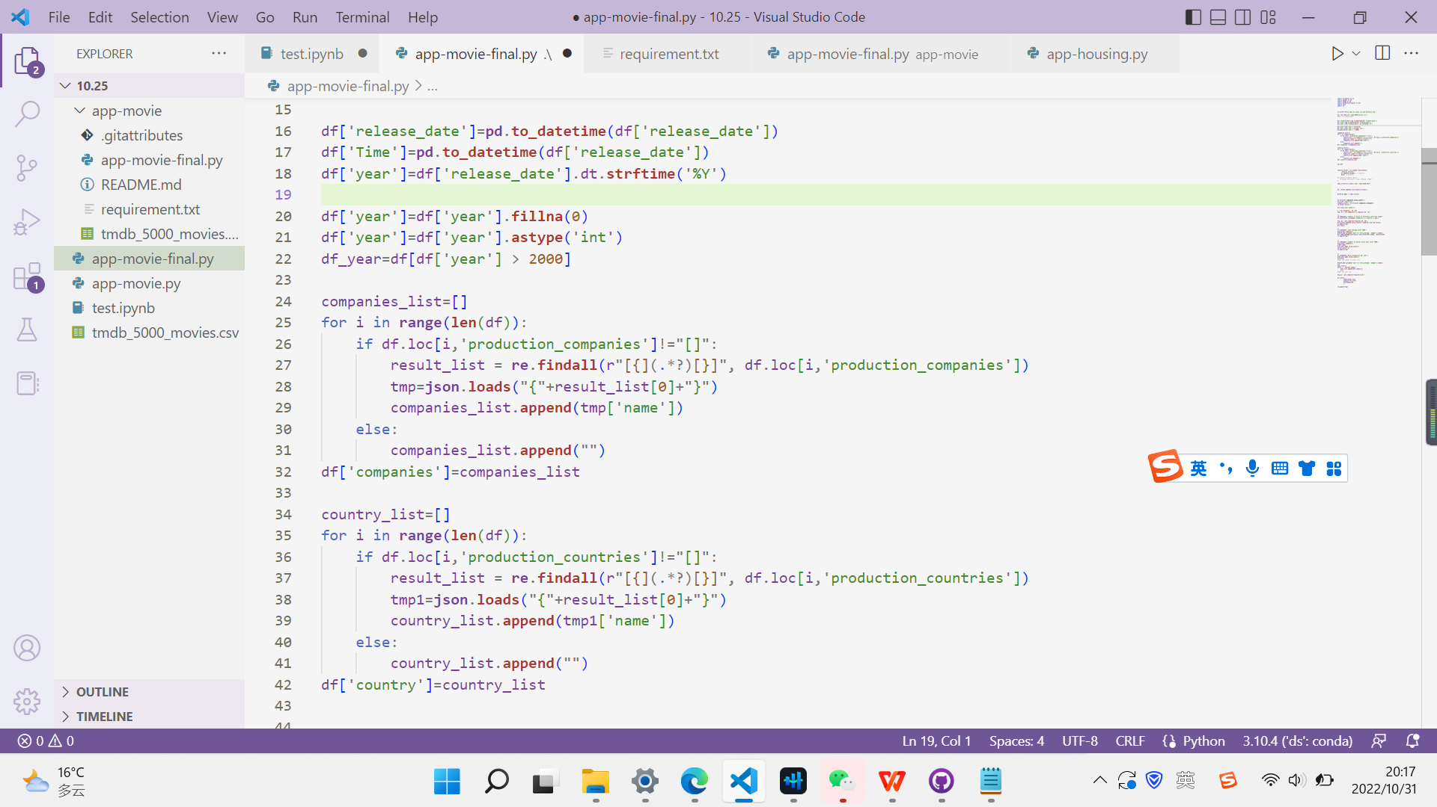
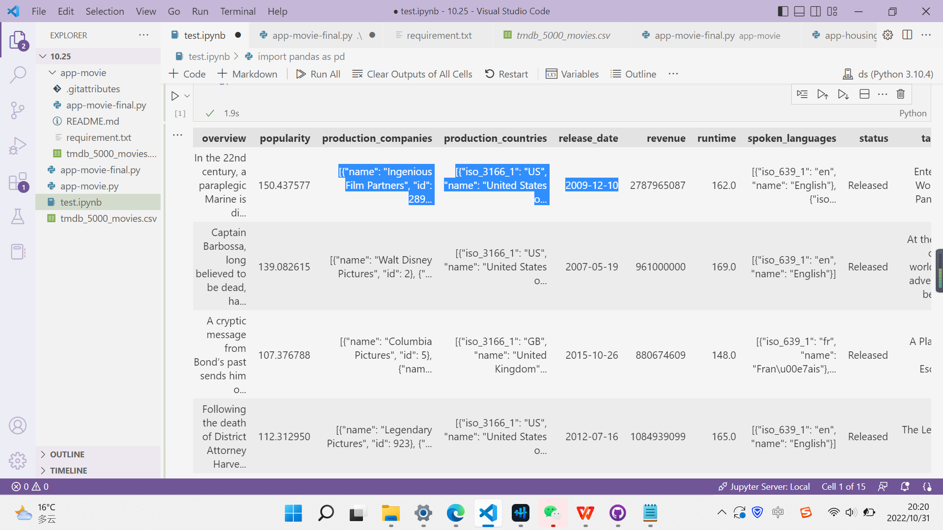
APP demo

Slide 16
Thanks

